Slide 1
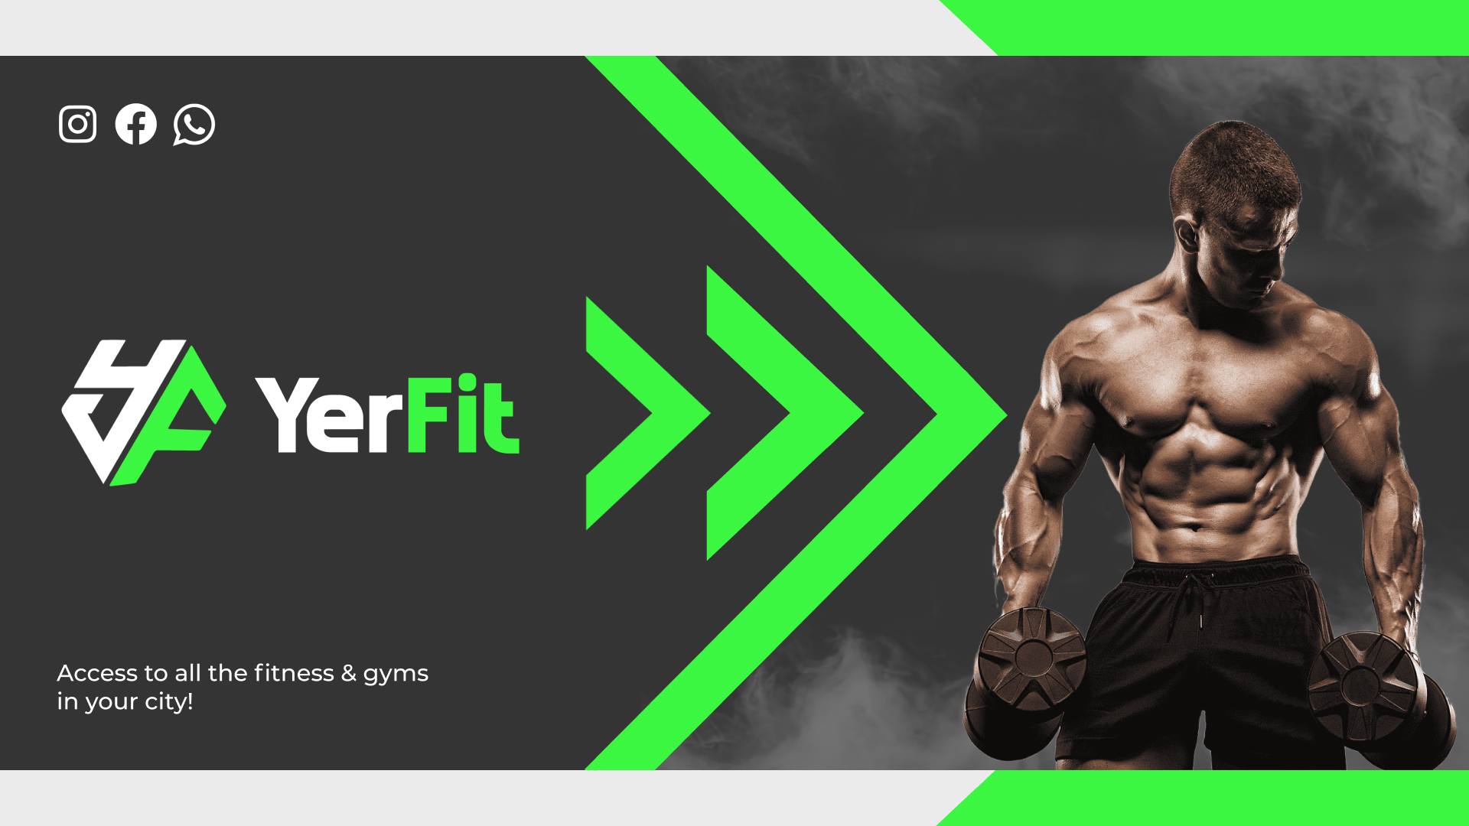
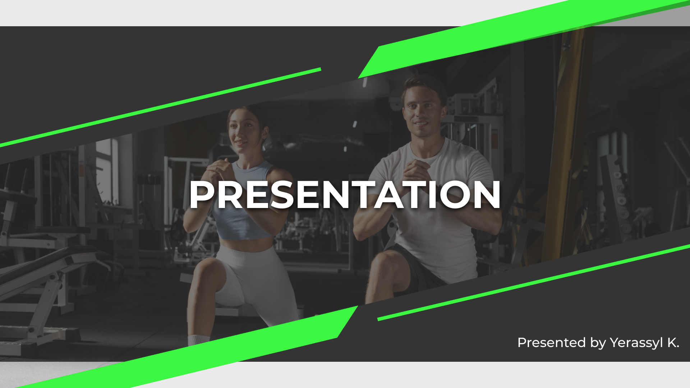

Slide 3
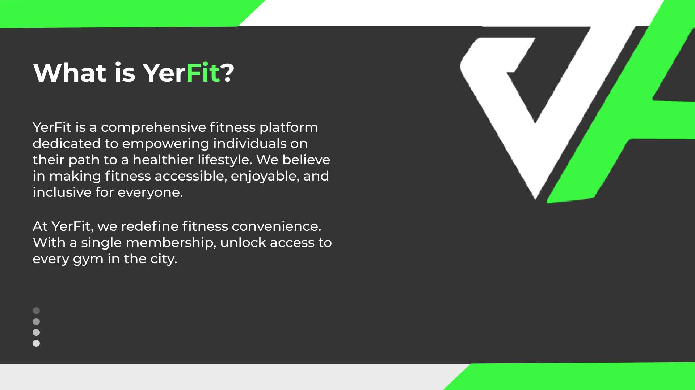

Slide 4
YerFit’s Mission
Accessibility
Enjoyability
Inclusivity
Ensuring fitness is an enjoyable experience
Creating a fitness community that embraces diversity
Making fitness accessible for everyone

Slide 5
YerFit’s Mission
Accessibility
Enjoyability
Inclusivity
Ensuring fitness is an enjoyable experience
Creating a fitness community that embraces diversity
Making fitness accessible for everyone

Slide 6
YerFit’s Mission
Accessibility
Enjoyability
Inclusivity
Ensuring fitness is an enjoyable experience
Creating a fitness community that embraces diversity
Making fitness accessible for everyone

Slide 7

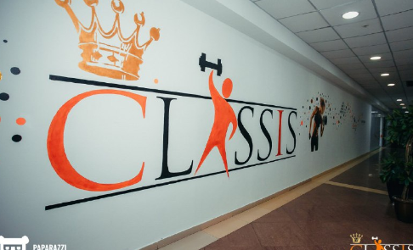
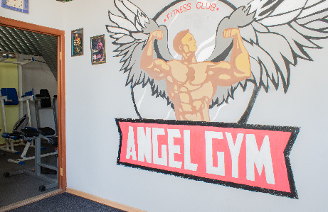
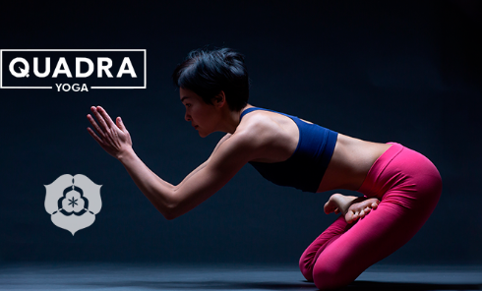
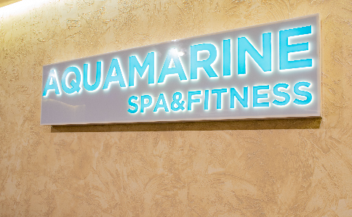
FITNESS
FILIALS
Astana City

Slide 8
FITNESS
FILIALS
Astana City

Slide 9
Quadra Yoga
The studio specializes in the direction of Quadra Yoga - a symbiosis of yoga and fitness

Slide 10
Aquamarine
In Aquamarine sports and fitness complex located in Ramada hotel you have access to swimming pool and gym

Slide 11
Angel Gym
The Angel Gym on Saina, located on the second floor of the building, is designed for physical and strength training

Slide 12
Classis Club
The Classis club practices an individual approach to each client, and democratic prices make the complex affordable

Slide 13
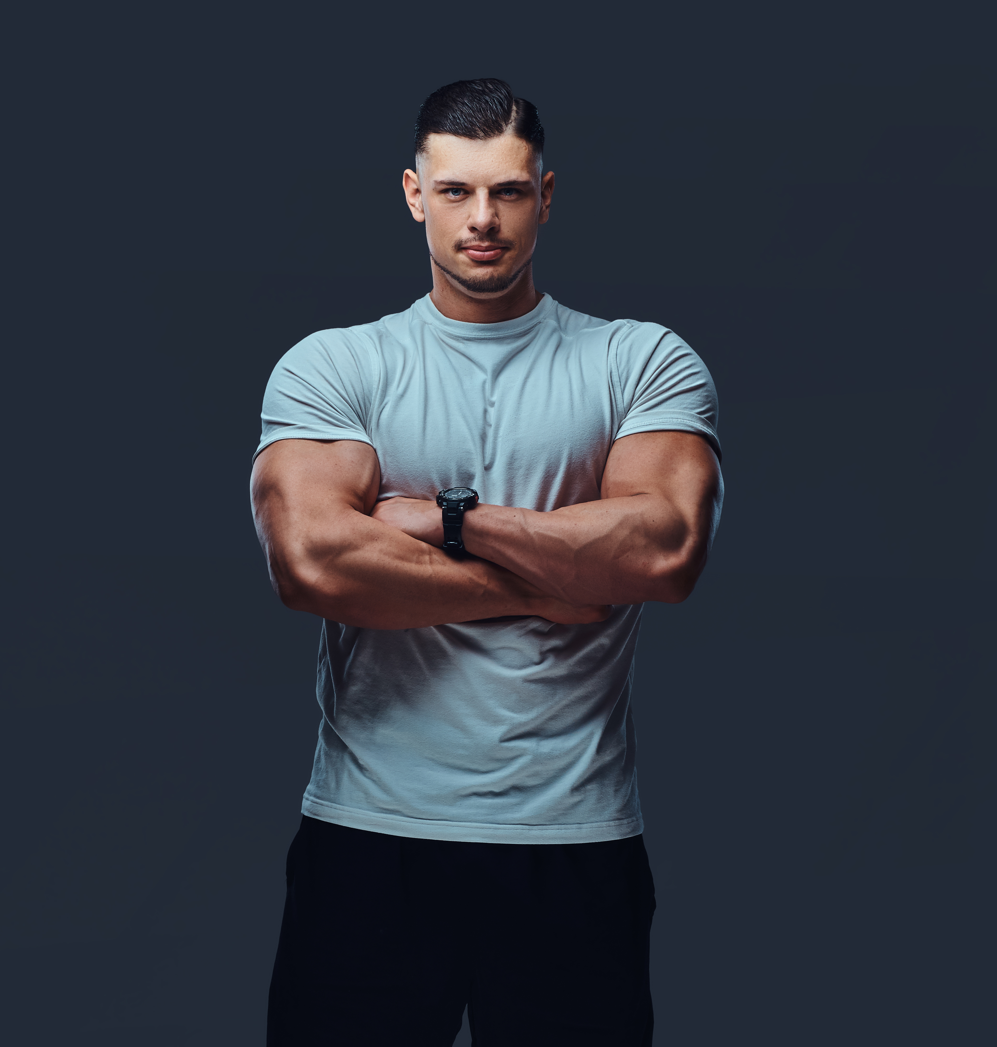

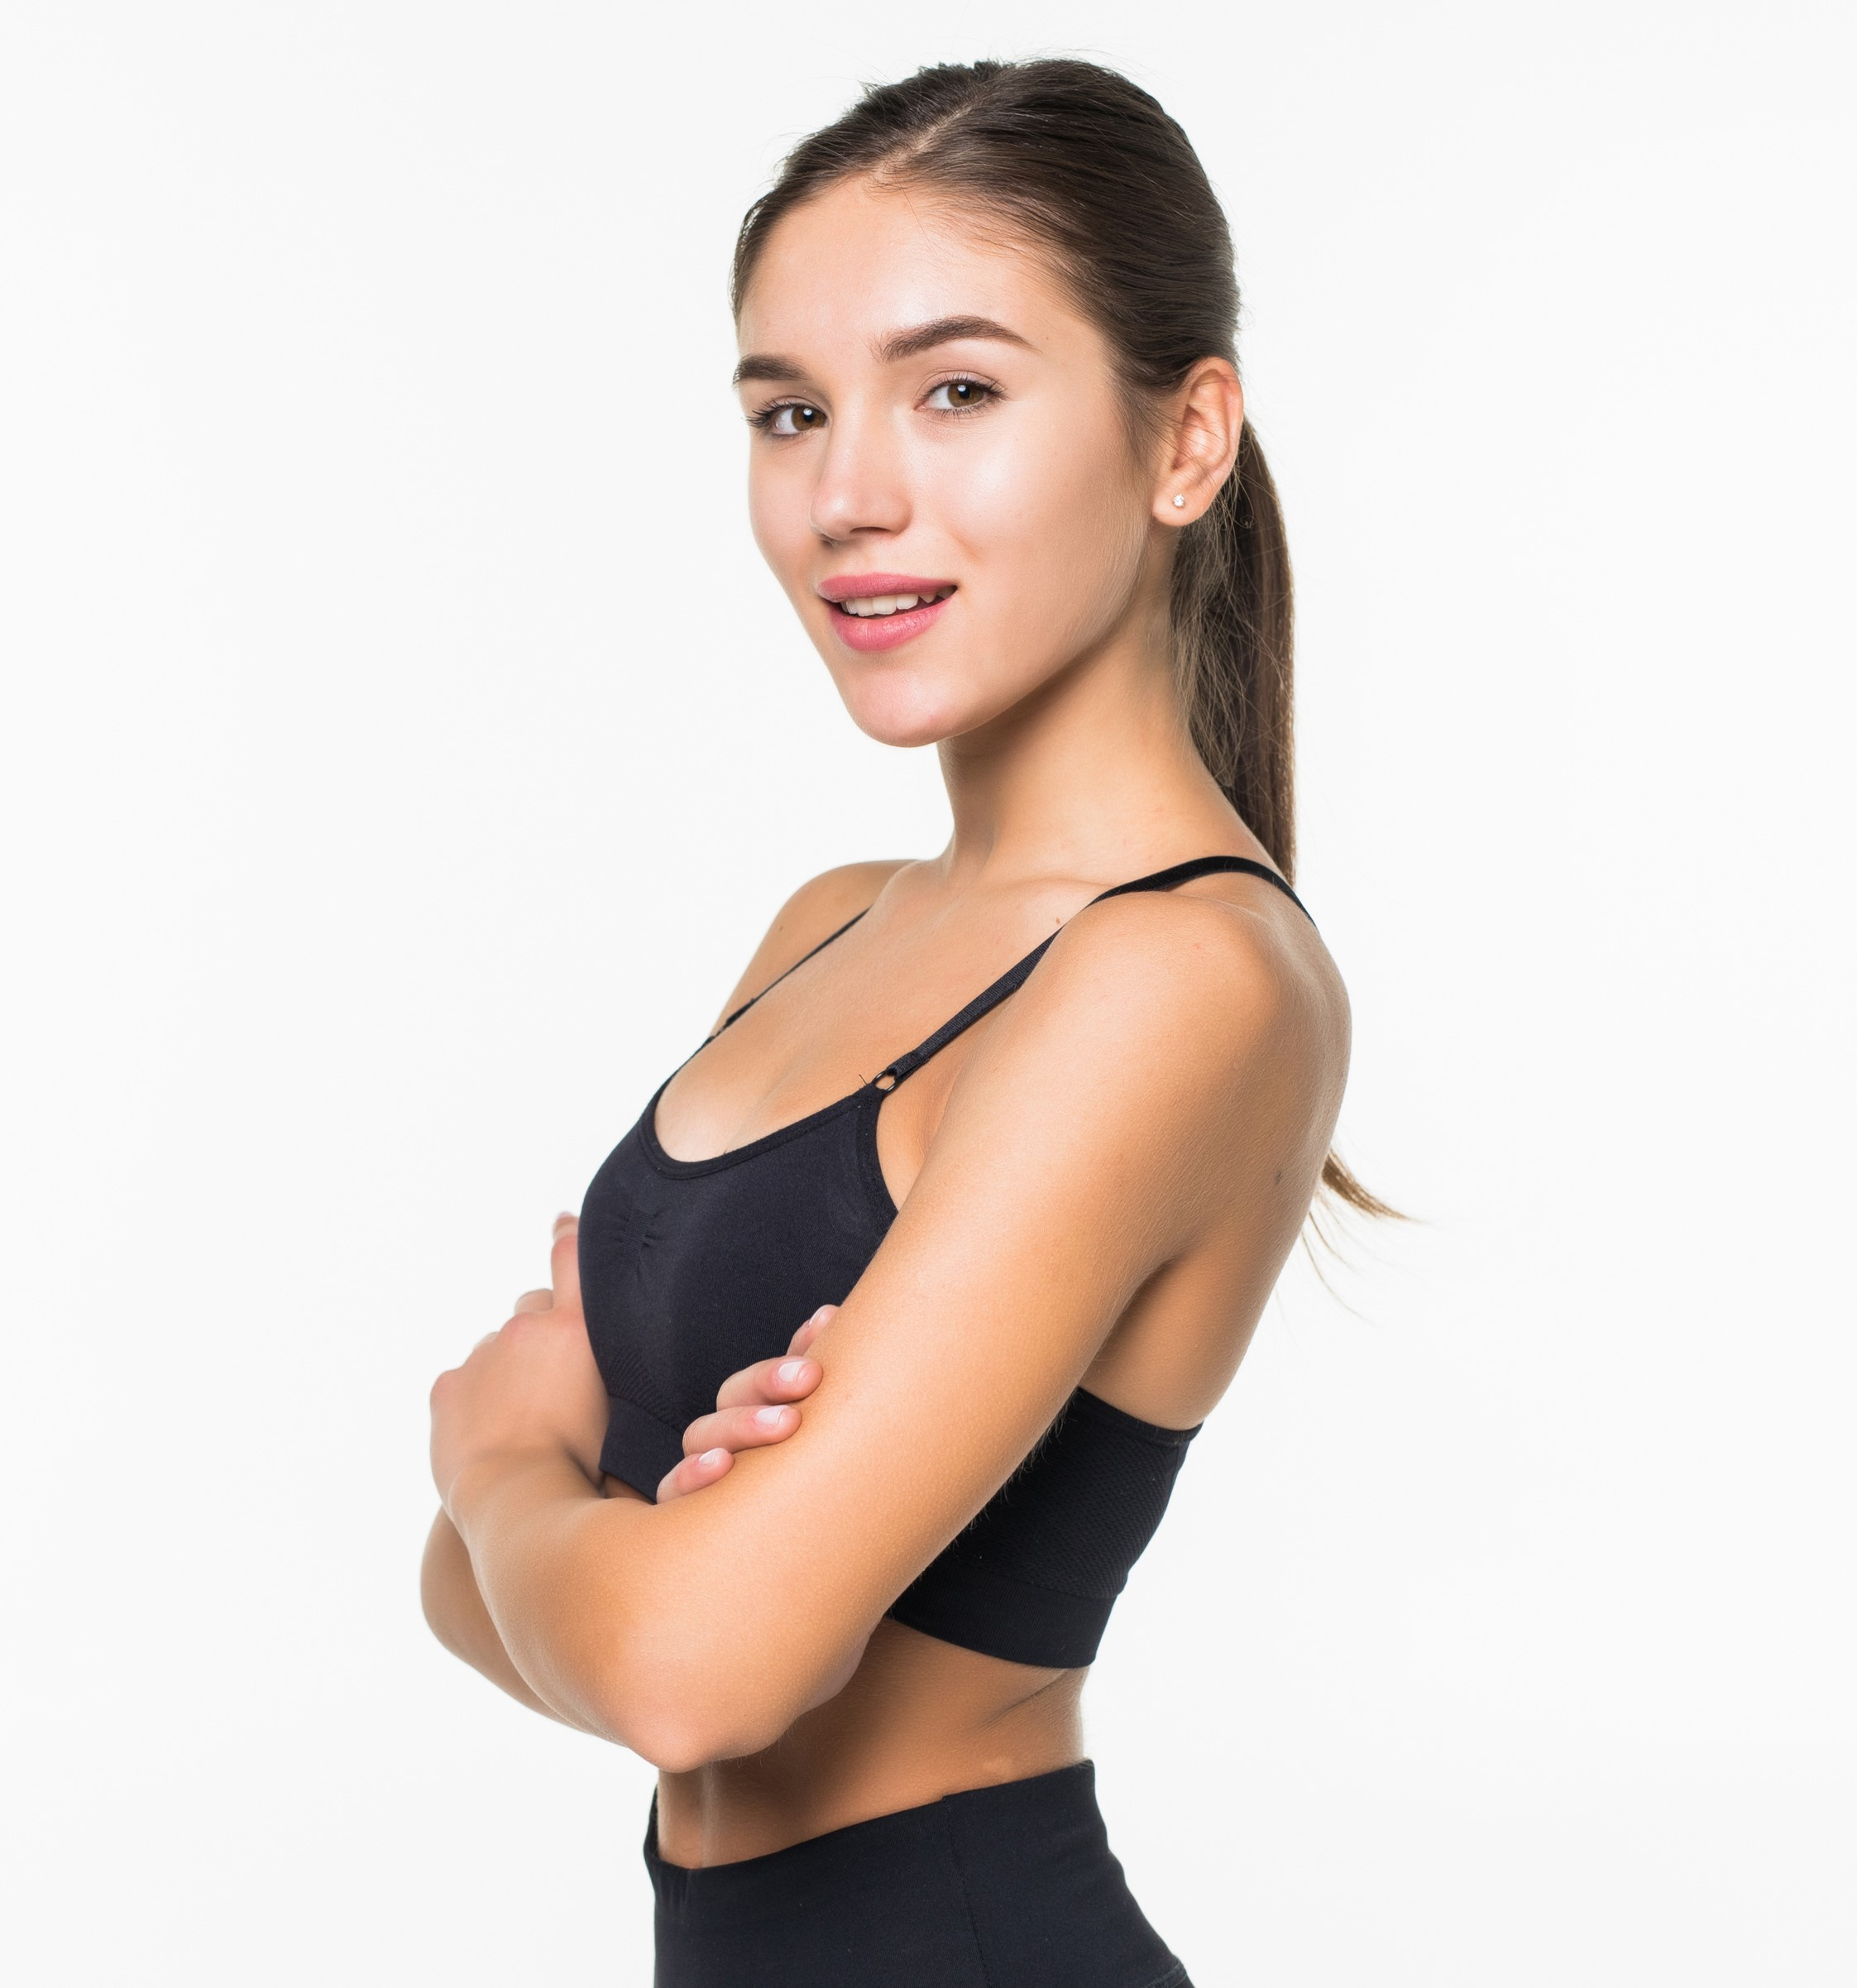
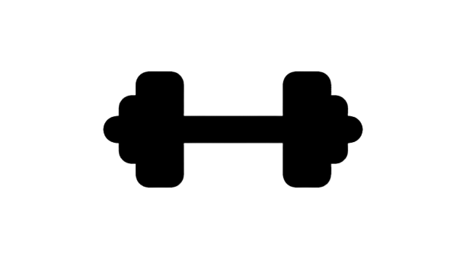
Almas Kurganov
Billy Herrington
Ayana Rakhimova
Trainer
Trainer & Gym Boss
Trainer

Slide 14

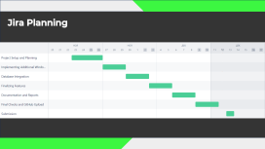
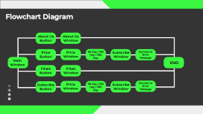
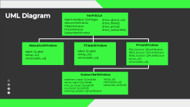


Slide 15

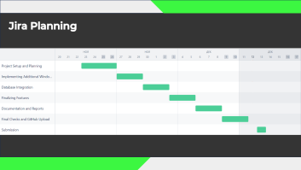
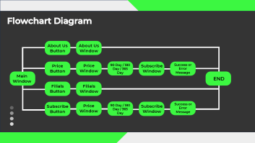

Slide 16
UML Diagram
YerFitGUI
MainInterface: QWidget
AboutUsWindow
FilialsWindow
PriceWindow SubscribeWindow
show_about_us()
show_filials() show_price() show_subscribe()
AboutUsWindow
FilialsWindow
PriceWindow
label: QLabel
setup_ui()
retranslate_ui()
label: QLabel
setup_ui()
retranslate_ui()
90d_button: QPushButton
180d_button: QPushButton
365d_button: QPushButton
setup_ui()
retranslate_ui()
SubscribeWindow
cardnum_input: QLineEdit
name_input: QLineEdit
mm_yy_input: QLineEdit
cvv_input: QLineEdit
continue_button: QPushButton
setup_ui()
retranslate_ui() subscribe_clicked()

Slide 17
Flowchart Diagram
About Us
Button
About Us
Window
Price
Button
Price
Window
90 Day / 180 Day / 365 Day
Subscribe
Window
Success or Error Message
Main Window
END
Filials
Button
Filials
Window
Subscribe
Button
Price
Window
90 Day / 180 Day / 365 Day
Subscribe
Window
Success or Error Message

Slide 18
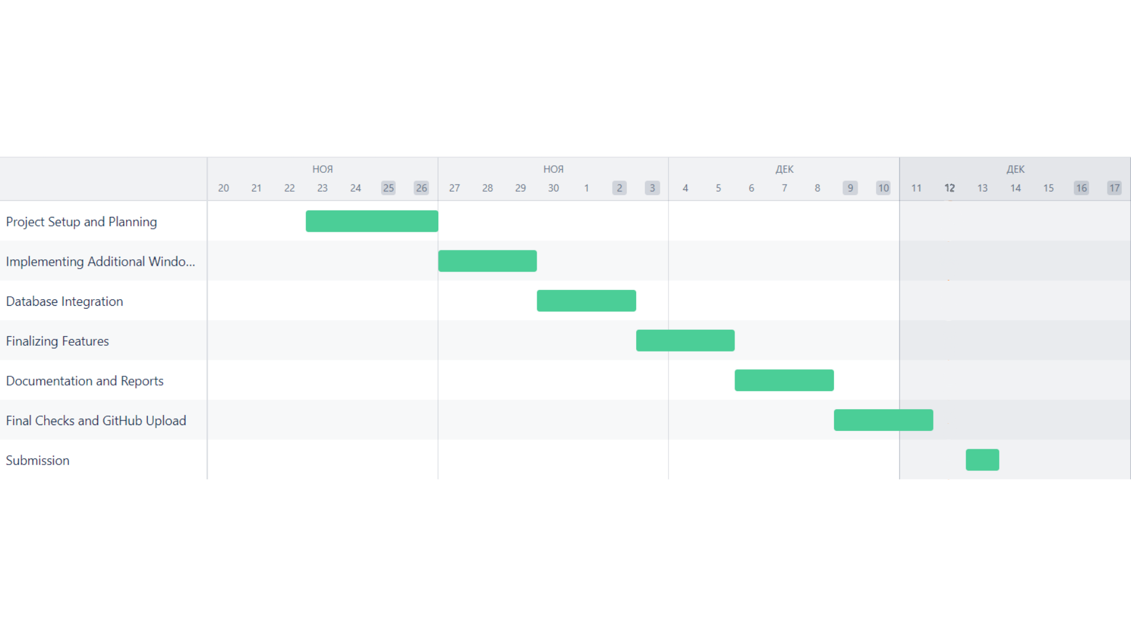
Jira Planning

Slide 19
Frameworks
PyQt5 is a set of Python bindings for Qt libraries, enabling developers to create cross-platform applications with a native look and feel. It combines the power of the Qt framework with the simplicity and flexibility of the Python programming language.
Rich Widgets: Offers a comprehensive set of Qt widgets for building diverse and interactive user interfaces.
Signal and Slot Mechanism: Facilitates communication between different components in an application, enhancing flexibility.
Cross-Platform Compatibility: Enables the development of applications that can seamlessly run on various operating systems.
Qt Designer Integration: Integrates smoothly with Qt Designer, allowing for the visual design of UIs and automatic code generation.

Slide 20
Frameworks
Qt Designer is a visual design tool provided by the Qt framework for creating graphical user interfaces. It's a powerful tool that simplifies the process of designing and building UIs.
Drag-and-Drop Interface: Simplifies UI design by allowing developers to visually place widgets on a form.
Integration with PyQt5: Generates .ui files that describe UI designs, which can be converted to Python code for PyQt5 projects.
Widget Box: Provides a collection of standard Qt widgets for easy inclusion in UI designs, along with support for custom widgets.
Property Editor: Streamlines customization by offering an editor for modifying widget properties.

Slide 21

THANKS
FOR AT
TENTION

